Slide 1


Spin-based Neuromorphic Computing (Simulation)
Presented by: CHONG TIAN EN
Supervised by: S.N. Piramananyagam
Associate Professor
Division of PAP, SPMS
Co-supervised by: Mohamed M. Sabry
Assistant Professor
School of Computer Science and Engineering
31
st
January 2020

Slide 2


Neuromorphic Computing
Hardware based implementation of neural network
Application-Specific Integrated Circuit (ASIC)
Not for General Purpose Computing (Forget YouTube, Email, … etc)

Slide 3
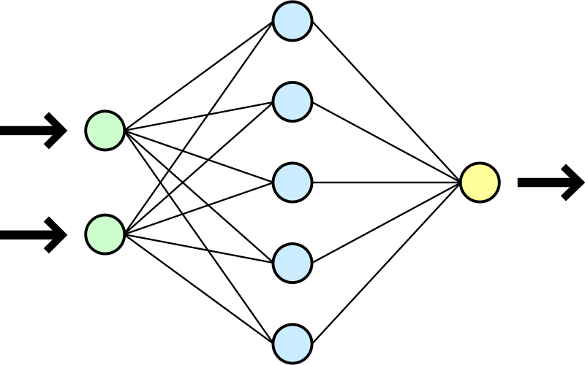
Neural Network

Slide 4
Why Neuromorphic Computing?
Huge application in AI Computer Vision
Mimic human brain neuron and synapse network
Very efficient for visual object recognition
Low power consumption
Deeper layer network can extract subtler visual details
Network output can be fed for image classification

Slide 5

Why Neuromorphic Computing?
Huge application in AI Computer Vision
Mimic human brain neuron and synapse network
Very efficient for visual object recognition
Low power consumption
Deeper layer network can extract subtler visual details
Network output can be fed for image classification

Slide 6
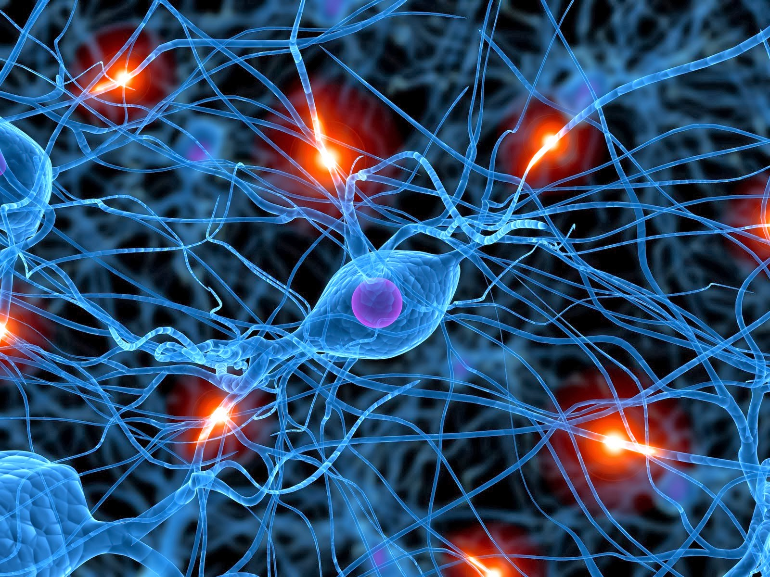
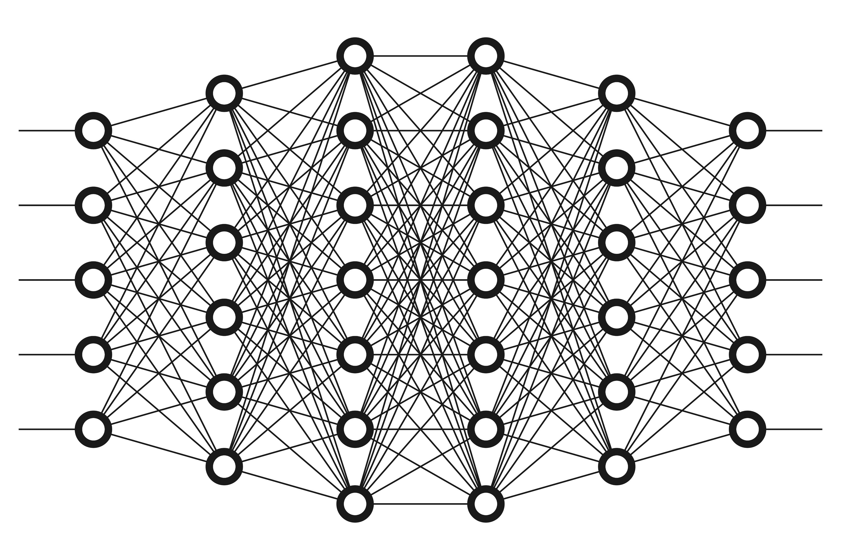
Why Neuromorphic Computing?

Slide 7
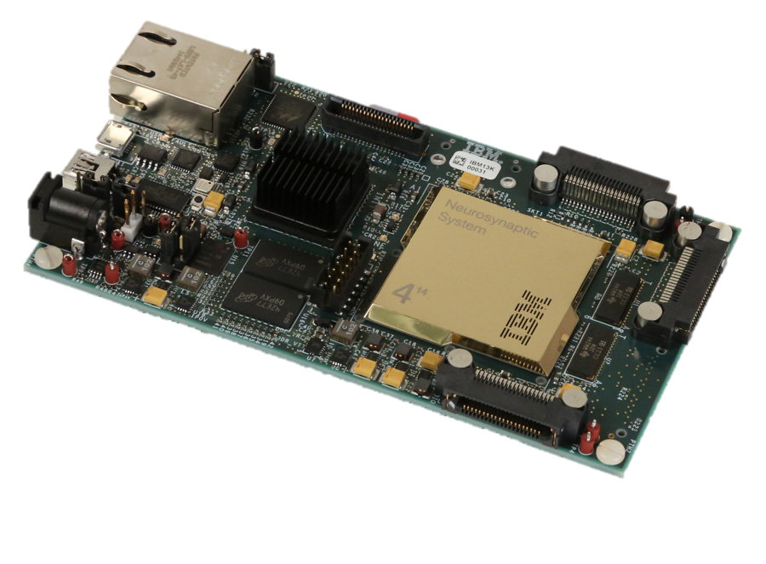
IBM TrueNorth Chip
4096 cores
256 neurons/core
256 synapses/neuron
Only consumes 63mW vs 500W desktop
(Neuromorphic Hardware: Trying to Put Brain Into Chips 2020)

Slide 8
Motivation (Use of Spintronics)
Originally used in hard disk drive read/write head
Involve in:
Spin Transfer Torque(STT)
Spin Orbit Transfer (SOT)
Tunneling Magnetoresistance (TMR)
Giant Magnetoresistance (GMR)
for magnetoresistive application like Magnetoresistive Random-access Memory (MRAM)

Slide 9
Motivation (Use of Spintronics)
Non-volatile (information retention during power loss) like Solid State Drive (SSD) unlike Metal Oxide Semiconductor (MOS) and Capacitors
Similar to SSD, Magnetic Tunnel Junction (MTJ) uses electron tunnelling
MTJ has smaller footprint to CMOS (Main reason)
But, MTJ uses electron spin orientation instead of electron presence in SSD (charge retention changes threshold voltage, causing wear out)

Slide 10
Spintronics Advantage vs Conventional SSD
Higher read/write speed
Lower power
No wear out (Unlimited read/write cycle)
(What is MRAM | MagnetoResistive Memory Technology | Electronics Notes 2020)

Slide 11
Objective
To create and simulate model of neuromorphic network, incorporated with spintronic MRAM (Spin Hall Effect) and compare the performance between neuromorphic model and traditional software implemented neural network model.
(What is MRAM | MagnetoResistive Memory Technology | Electronics Notes 2020)

Slide 12
Simulation Details (Outline)
Theory:
Synaptic Weight
Weight→Resistance
Matrix Implementation
Inverting Summing Operational Amplifier (OpAmp)
Actual Simulation Environment:
Cadence Development Environment with 65nm Process Design Kit (PDK)
Code Files
Programmable Scalable Network (Generated)

Slide 13
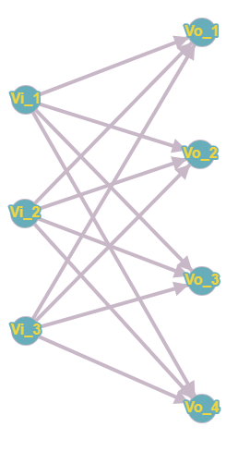
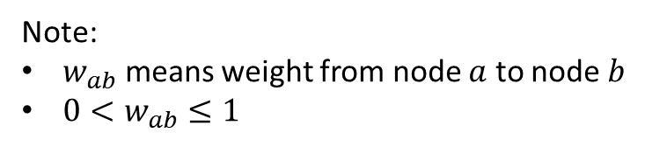
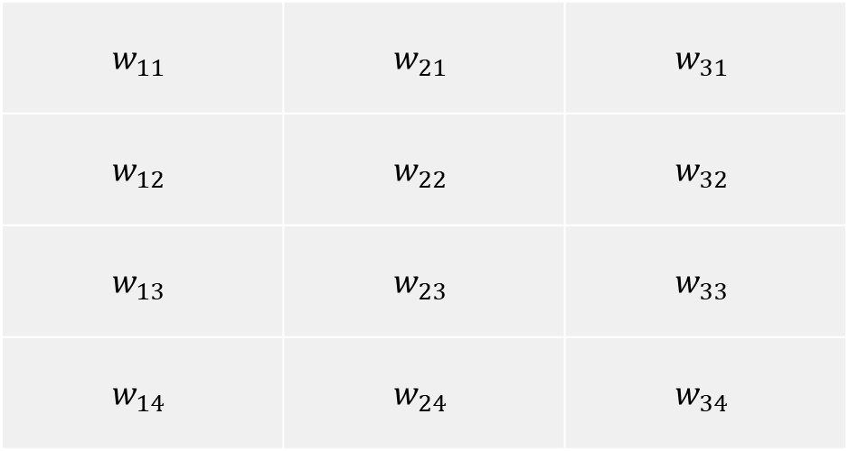
Synaptic Weight
$$w_{11}$$ | $$w_{21}$$ | $$w_{31}$$
$$w_{12}$$ | $$w_{22}$$ | $$w_{32}$$
$$w_{13}$$ | $$w_{23}$$ | $$w_{33}$$
$$w_{14}$$ | $$w_{24}$$ | $$w_{34}$$
Note:
$w_{ab}$ means weight from node $a$ to node $b$
$0<w_{ab}≤1$

Slide 14
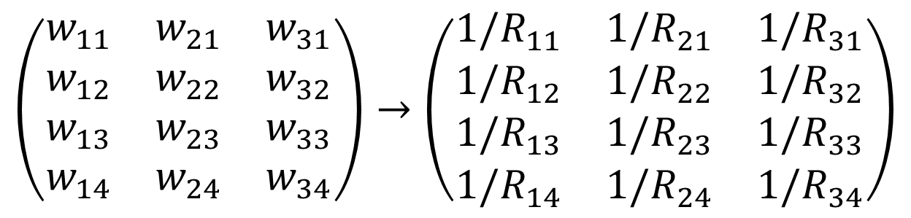
Weight $→$ Resistance
$$\left(\begin{matrix}w_{11} & w_{21} & w_{31} \\ w_{12} & w_{22} & w_{32} \\ w_{13} & w_{23} & w_{33} \\ w_{14} & w_{24} & w_{34}\end{matrix}\right)→\left(\begin{matrix}{1/R}_{11} & {1/R}_{21} & {1/R}_{31} \\ {1/R}_{12} & {1/R}_{22} & {1/R}_{32} \\ {1/R}_{13} & {1/R}_{23} & {1/R}_{33} \\ {1/R}_{14} & {1/R}_{24} & {1/R}_{34}\end{matrix}\right)$$
$$R=1/w$$

Slide 15
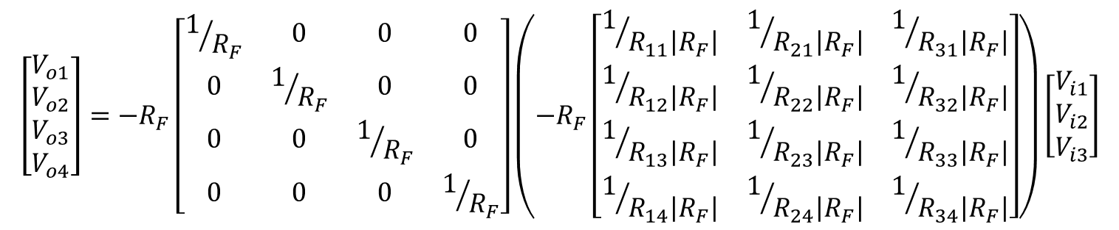
Matrix Implementation
$$\left[\begin{matrix}V_{o1} \\ V_{o2} \\ V_{o3} \\ V_{o4}\end{matrix}\right]=−R_{F}\left[\begin{matrix}1/{R_{F}} & 0 & 0 & 0 \\ 0 & 1/{R_{F}} & 0 & 0 \\ 0 & 0 & 1/{R_{F}} & 0 \\ 0 & 0 & 0 & 1/{R_{F}}\end{matrix}\right]\left(−R_{F}\left[\begin{matrix}1/{R_{11}\left|R_{F}\right|} & 1/{R_{21}\left|R_{F}\right|} & 1/{R_{31}\left|R_{F}\right|} \\ 1/{R_{12}\left|R_{F}\right|} & 1/{R_{22}\left|R_{F}\right|} & 1/{R_{32}\left|R_{F}\right|} \\ 1/{R_{13}\left|R_{F}\right|} & 1/{R_{23}\left|R_{F}\right|} & 1/{R_{33}\left|R_{F}\right|} \\ 1/{R_{14}\left|R_{F}\right|} & 1/{R_{24}\left|R_{F}\right|} & 1/{R_{34}\left|R_{F}\right|}\end{matrix}\right]\right)\left[\begin{matrix}V_{i1} \\ V_{i2} \\ V_{i3}\end{matrix}\right]$$

Slide 16
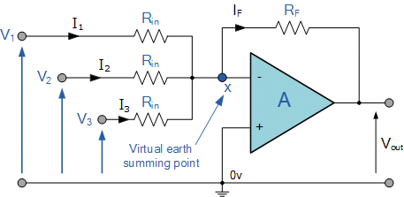
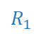
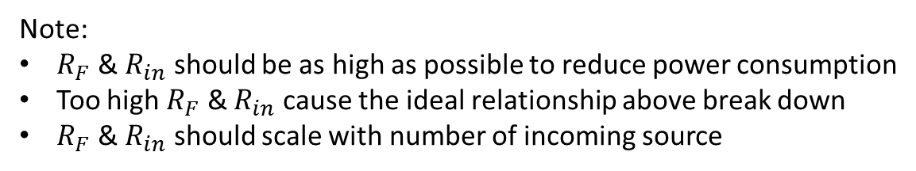
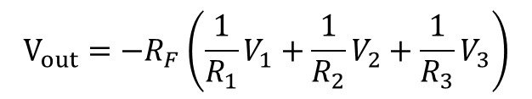
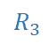
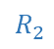
Inverting Summing OpAmp
$$R_{1}$$
$$R_{2}$$
$$R_{3}$$
Ideally,
$$V_{out}={−R}_{F}\left(\frac{1}{R_{1}}V_{1}+\frac{1}{R_{2}}V_{2}+\frac{1}{R_{3}}V_{3}\right)$$
Note:
$R_{F}$ & $R_{in}$ should be as high as possible to reduce power consumption
Too high $R_{F}$ & $R_{in}$ cause the ideal relationship above break down
$R_{F}$ & $R_{in}$ should scale with number of incoming source

Slide 17
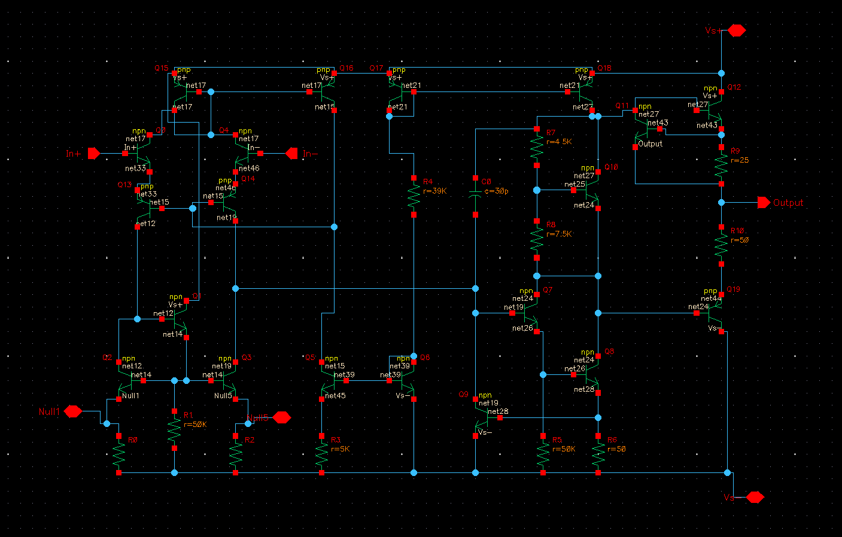
Tuned 741 Texas Instrument OpAmp Model

Slide 18
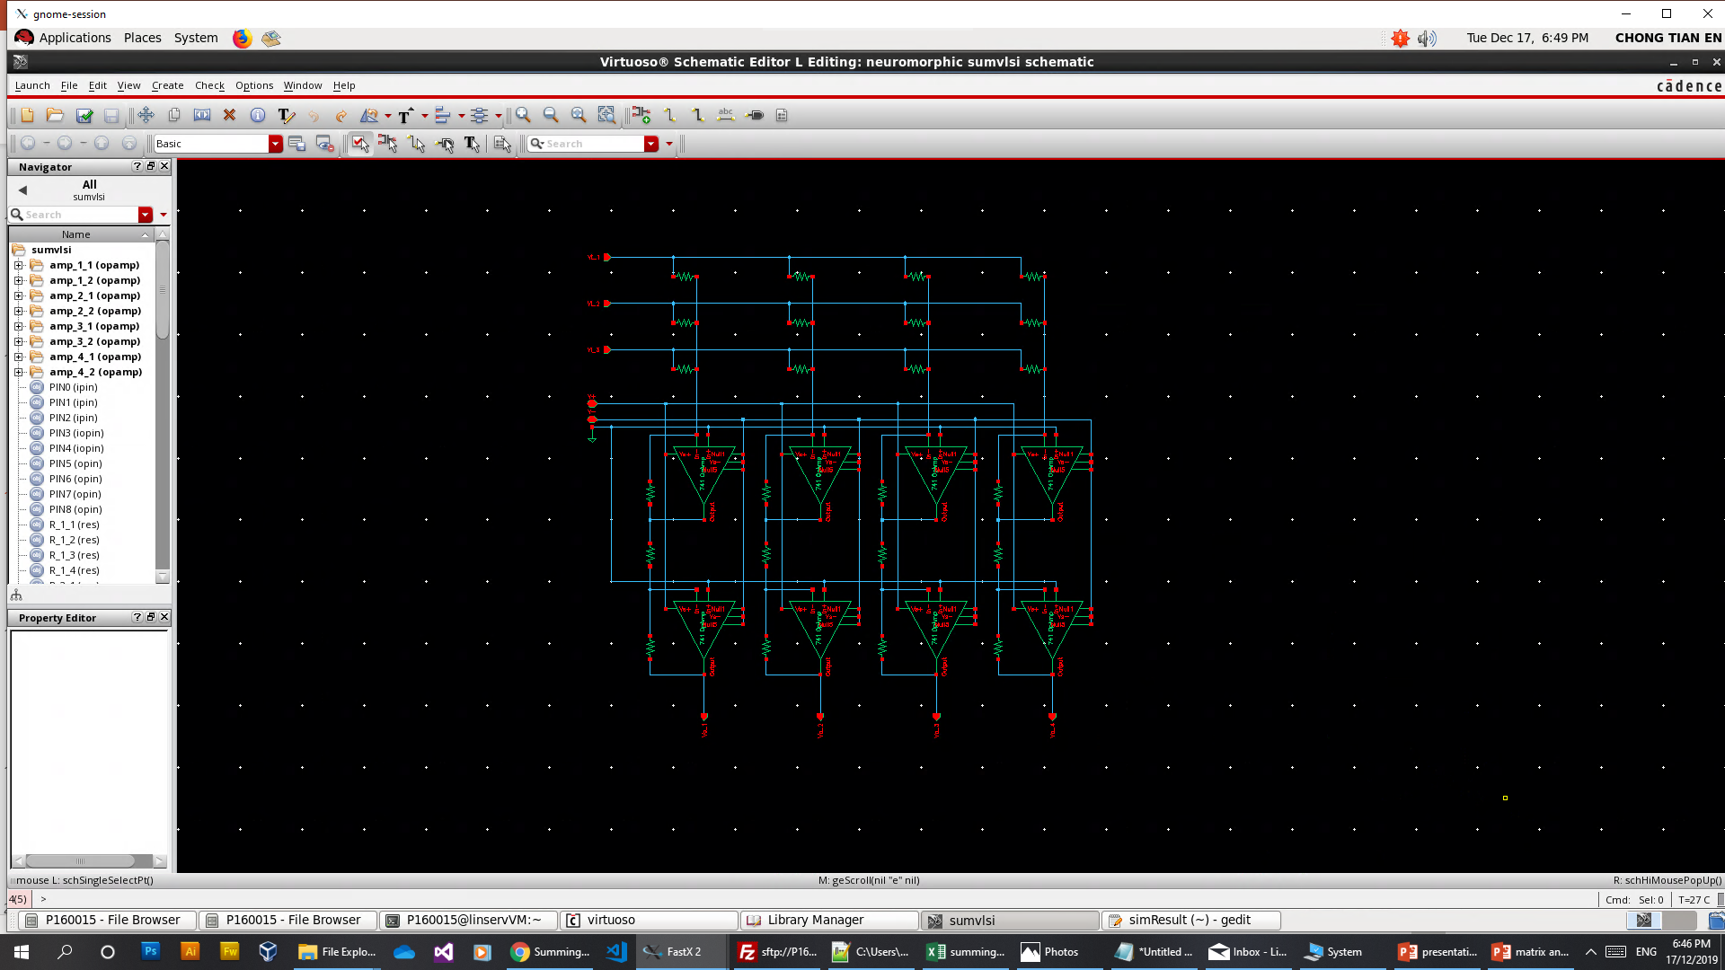
Cadence Development Environment with 65nm PDK

Slide 19
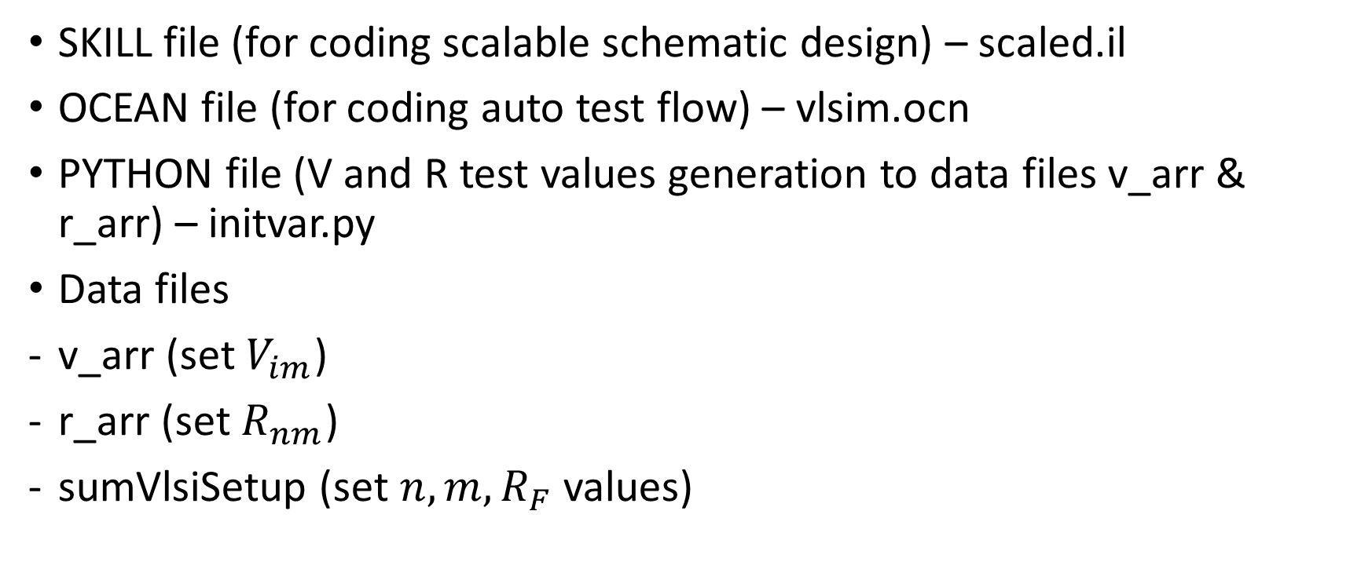
Code Files
SKILL file (for coding scalable schematic design) – scaled.il
OCEAN file (for coding auto test flow) – vlsim.ocn
PYTHON file (V and R test values generation to data files v_arr & r_arr) – initvar.py
Data files
v_arr (set $V_{im}$)
r_arr (set $R_{nm}$)
sumVlsiSetup (set $n,m,R_{F}$ values)

Slide 20
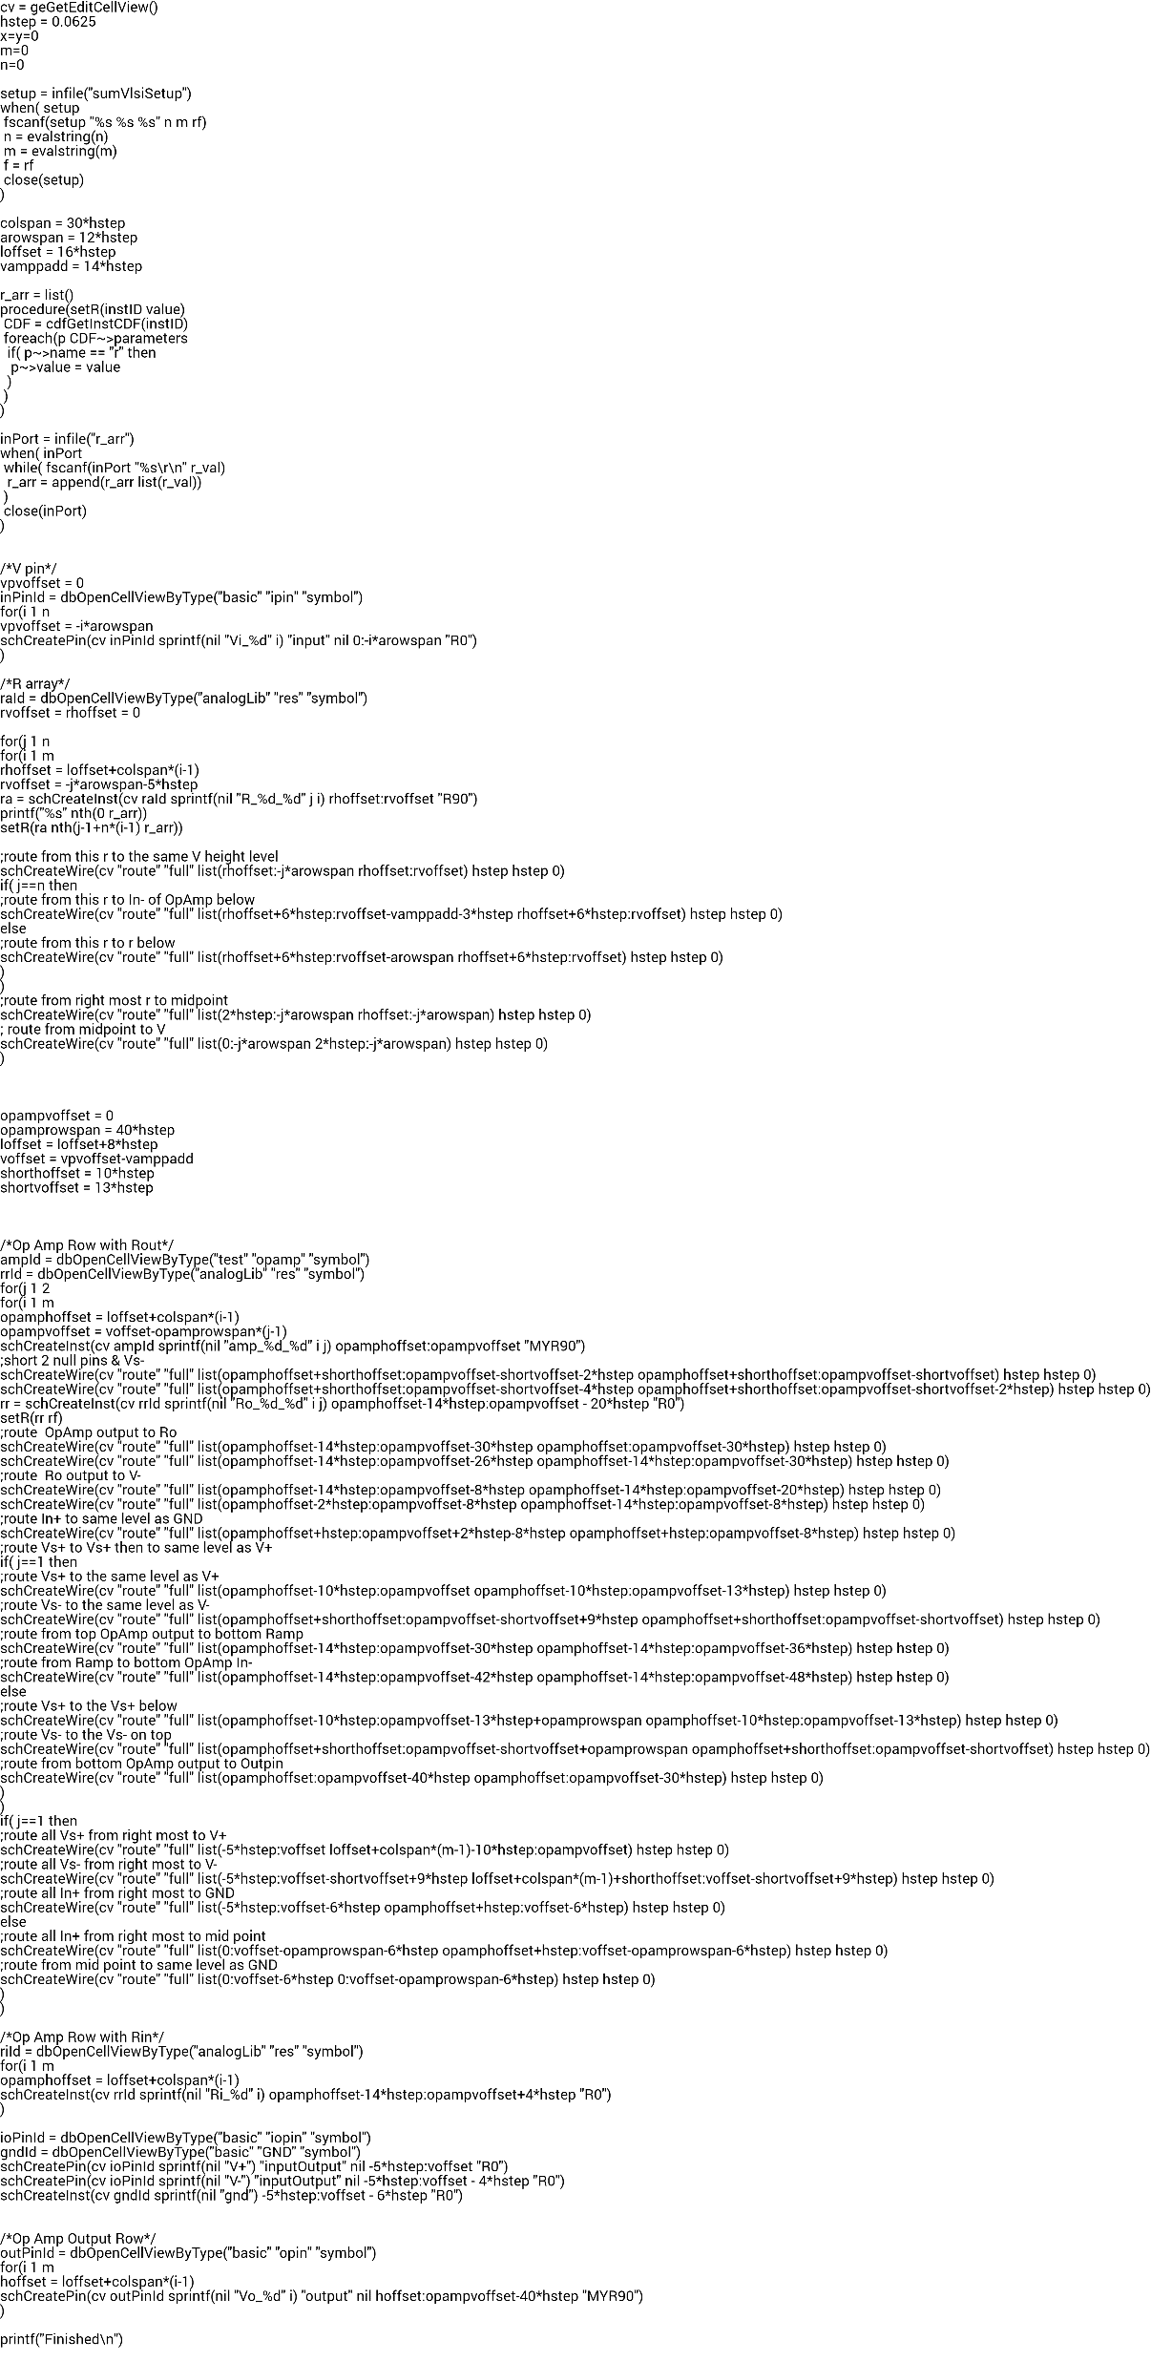
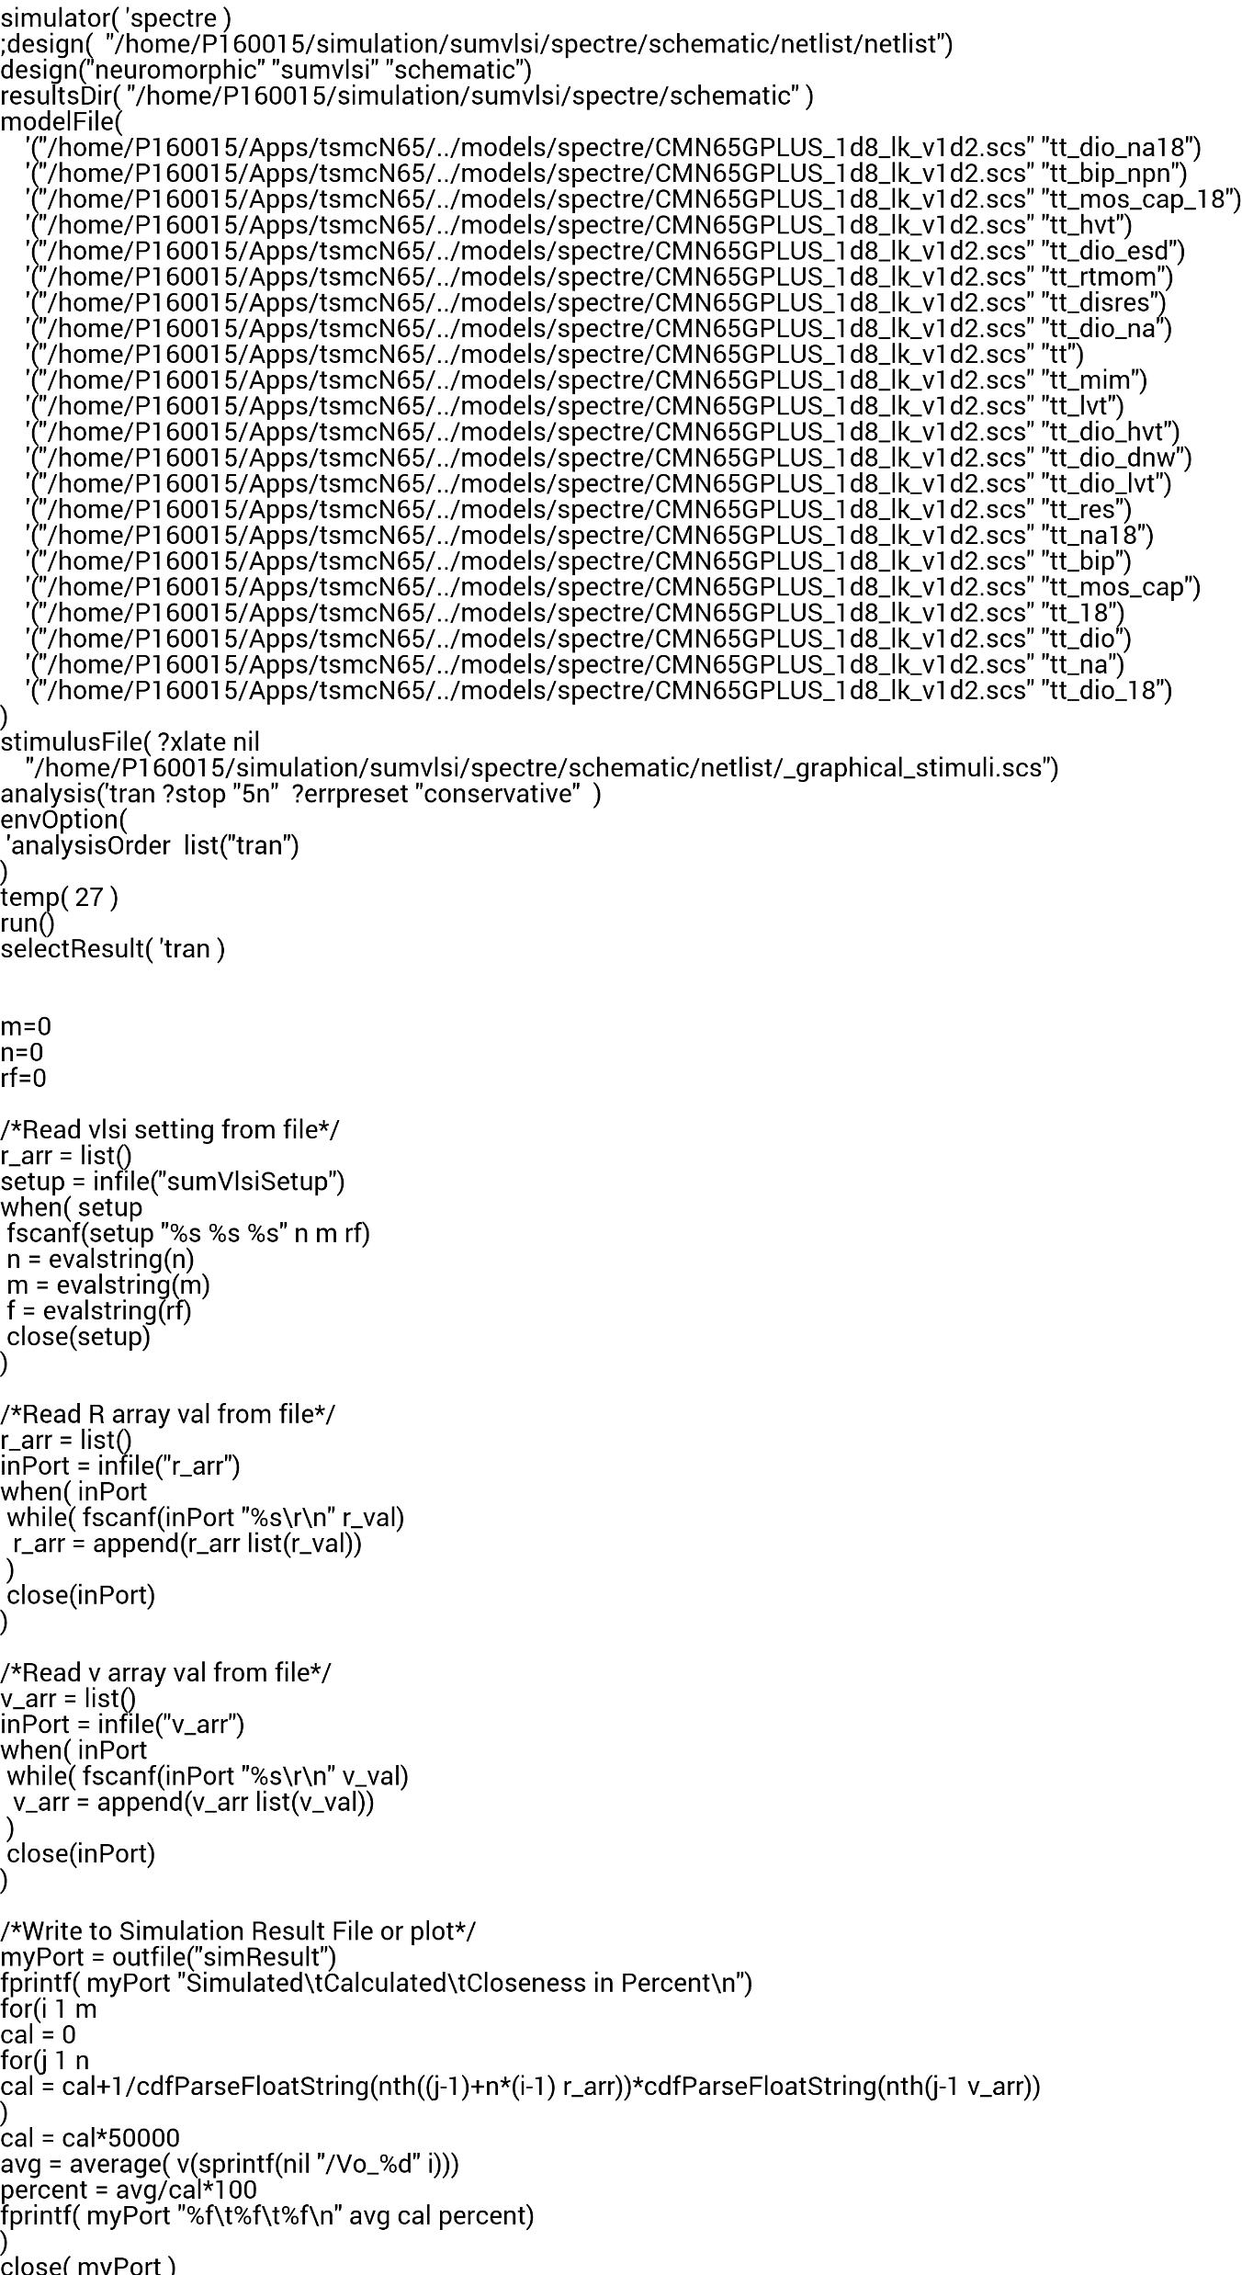
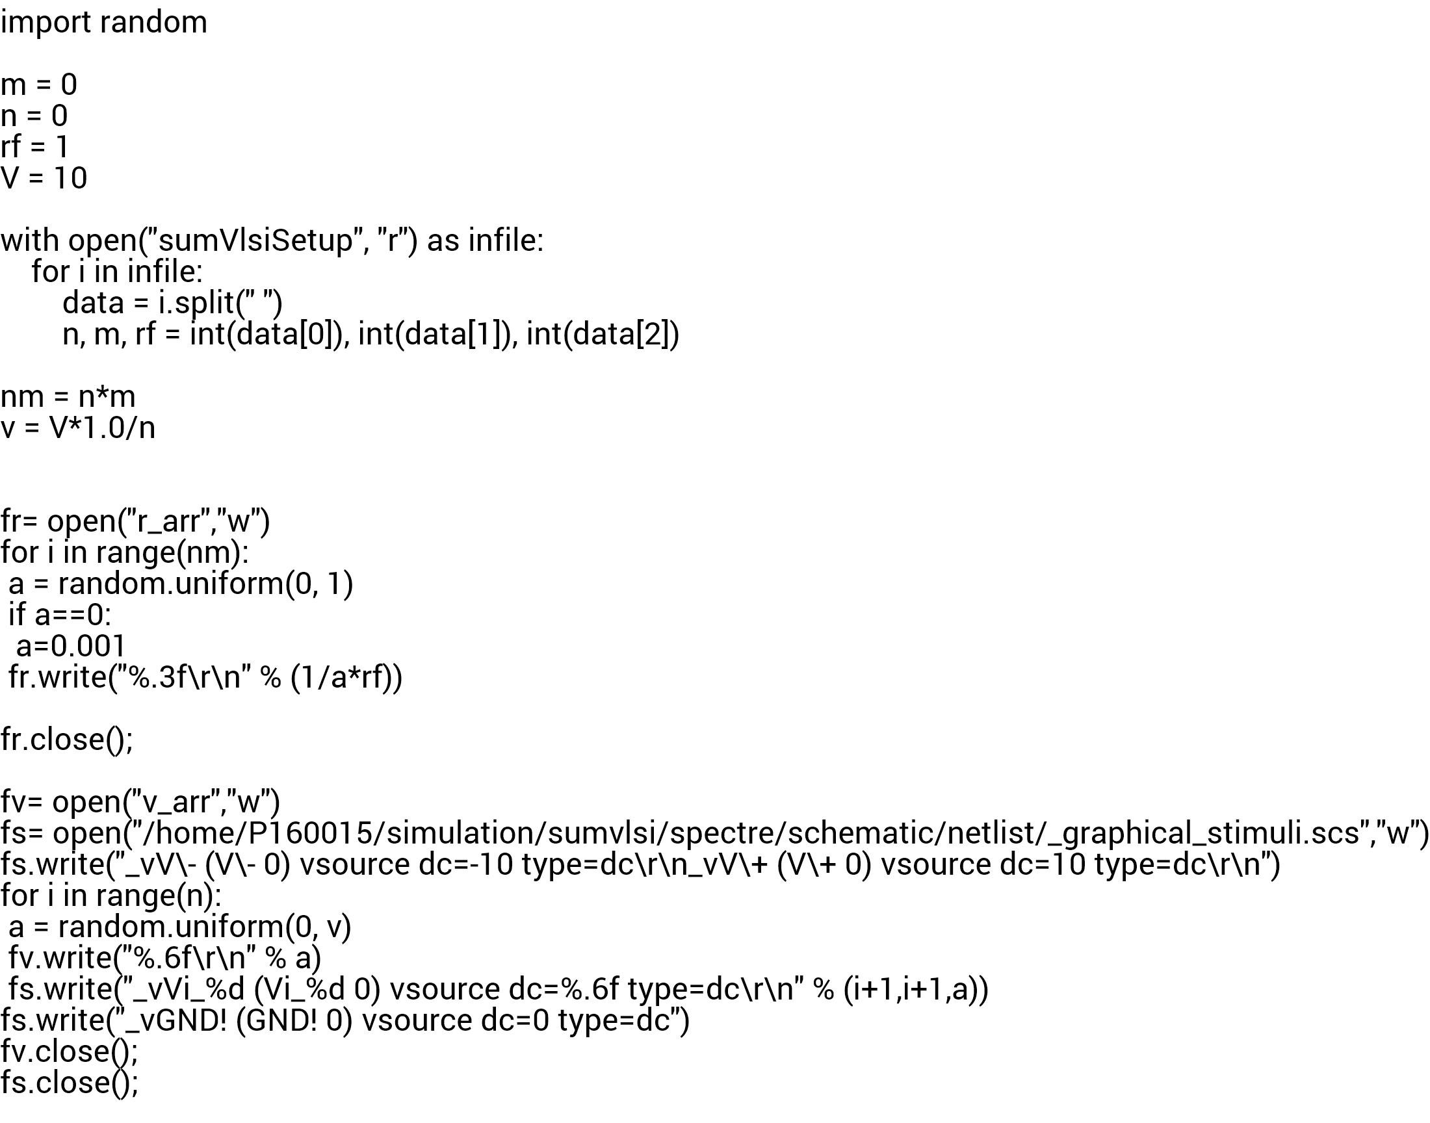
Code Files
scaled.il
vlsim.ocn
initvar.py

Slide 21
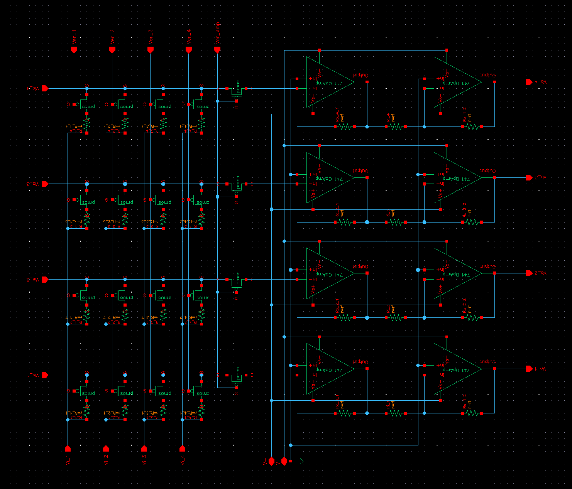
Programmable Scalable Network (Generated)
4 by 4 synapses
4 neurons

Slide 22
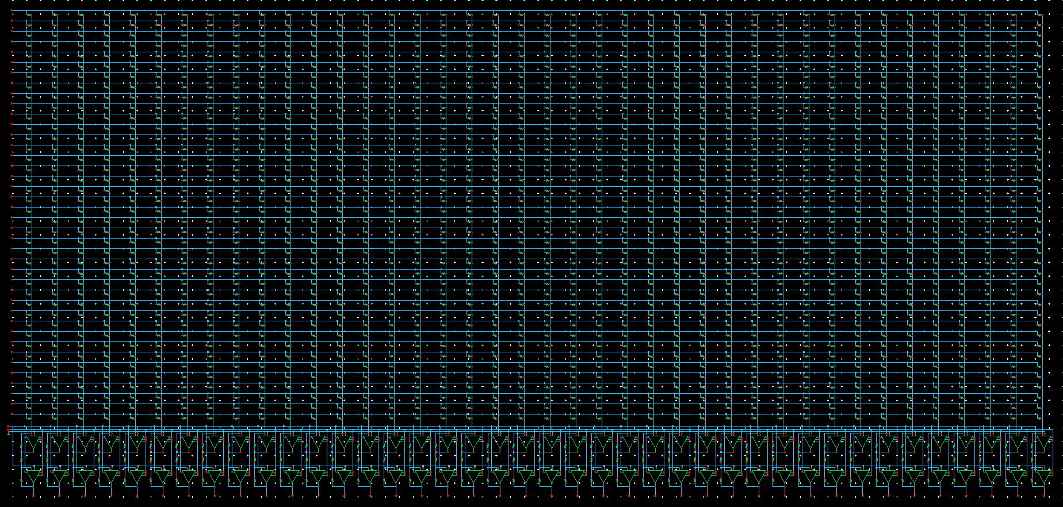
Programmable Scalable Network (Generated)
40 by 40 synapses
40 neurons

Slide 23
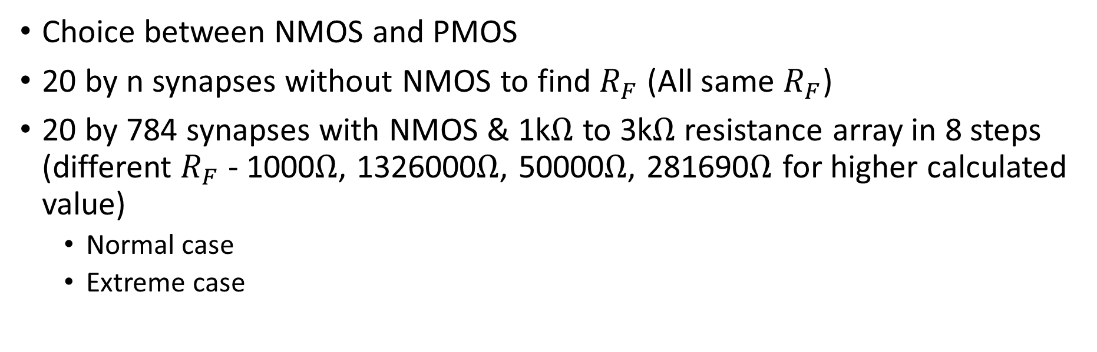
Simulation Result (Outline)
Choice between NMOS and PMOS
20 by n synapses without NMOS to find $R_{F}$ (All same $R_{F}$)
20 by 784 synapses with NMOS & 1k$Ω$ to 3k$Ω$ resistance array in 8 steps (different $R_{F}$ - 1000$Ω$, 1326000$Ω$, 50000$Ω$, 281690$Ω$ for higher calculated value)
Normal case
Extreme case

Slide 24
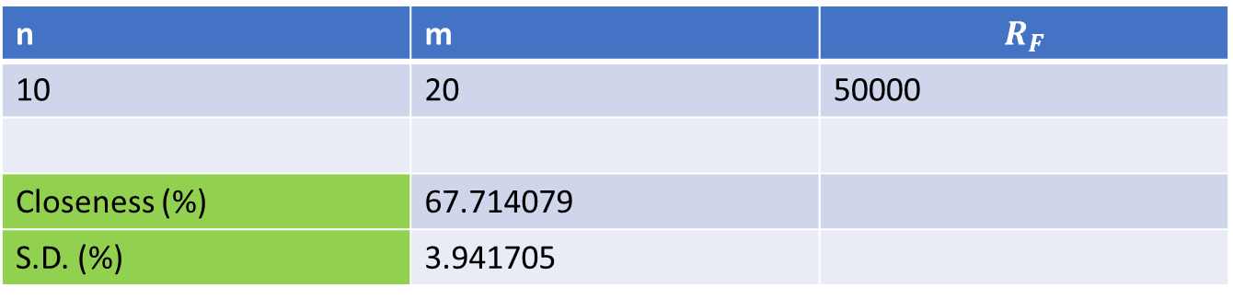

Choice between NMOS and PMOS
NMOS
n | m | $$R_{F}$$
10 | 20 | 50000
Closeness (%) | 80.305877
S.D. (%) | 3.034855
PMOS
n | m | $$R_{F}$$
10 | 20 | 50000
Closeness (%) | 67.714079
S.D. (%) | 3.941705

Slide 25
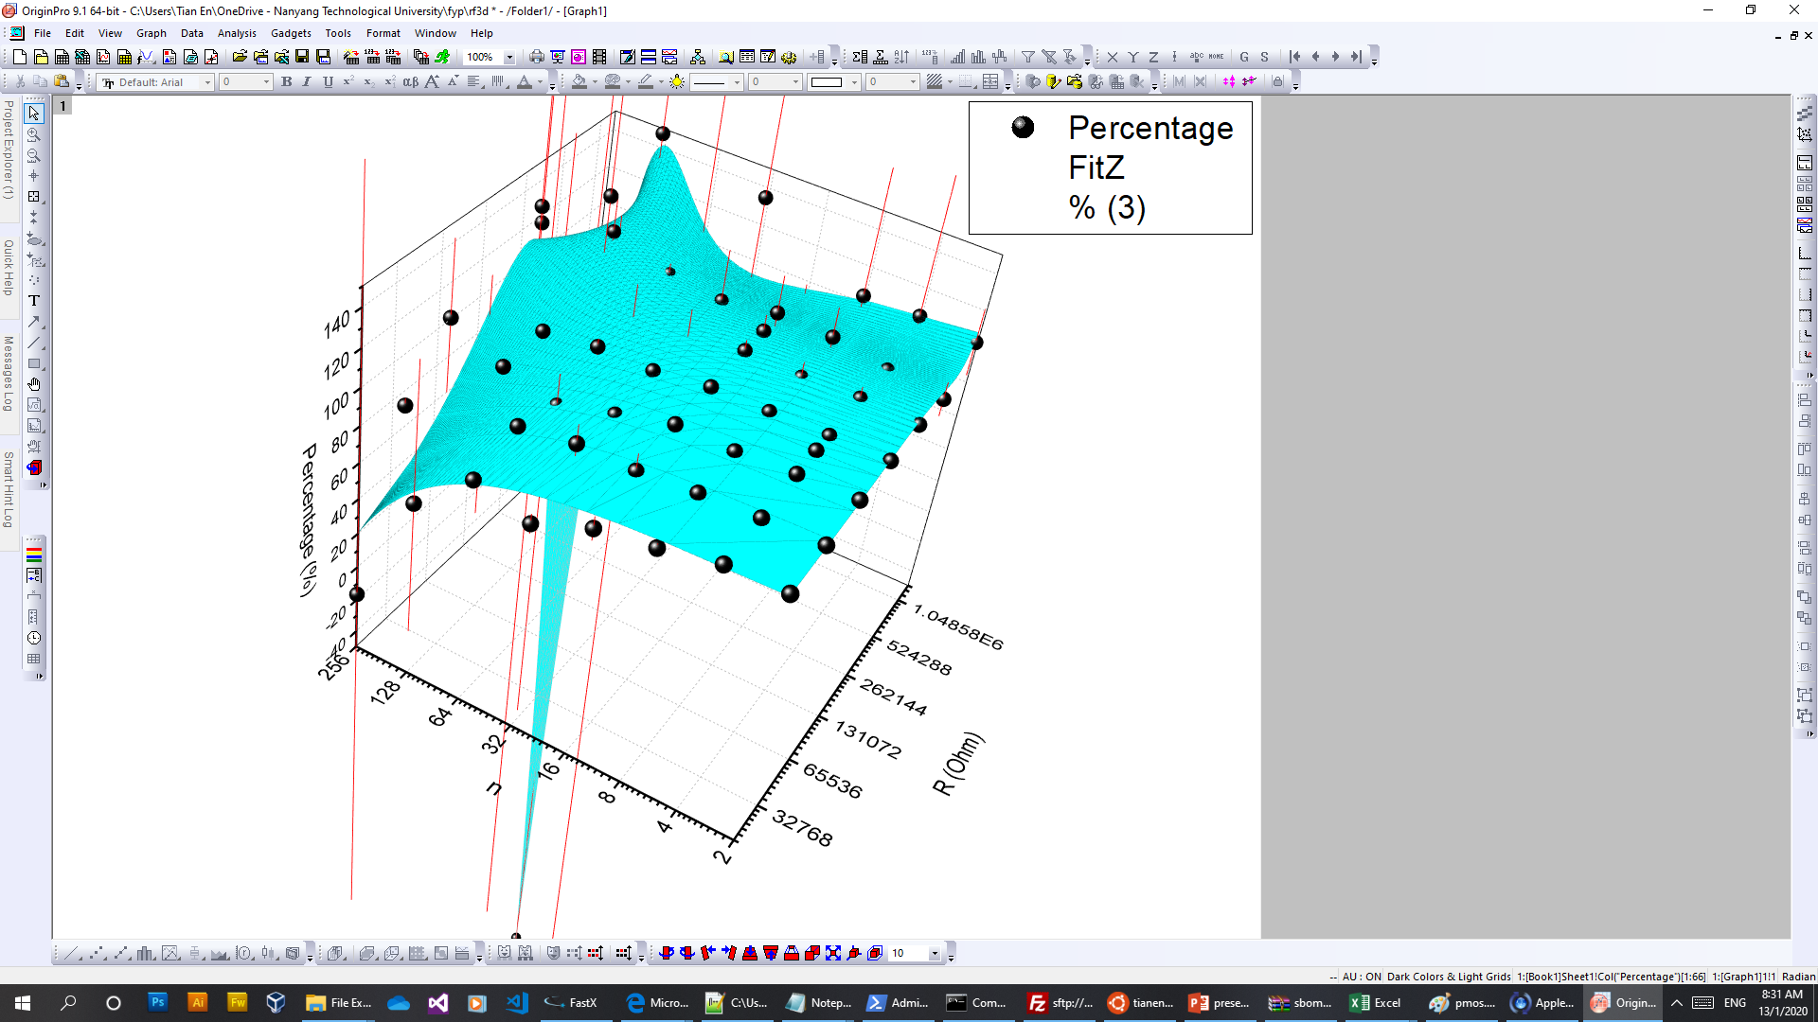
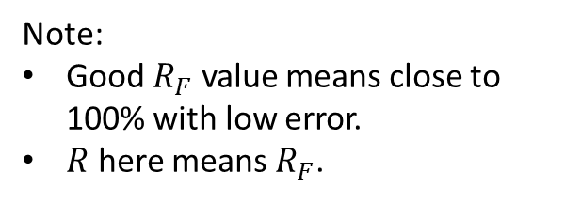
20 by n synapses without NMOS (determine $R_{F}$)
Note:
Good $R_{F}$ value means close to 100% with low error.
$R$ here means $R_{F}$.
Model xycube3 (User)
Equation a*(x^3)*(y^3)+b*(x^3)*(y^2)+c*(x^3)*y+d*(x^3)+e*(x^2)*(y^3)+f*(x^2)*(y^2)+g*(x^2)*y+h*(x^2)+i*x*(y^3)+j*x*(y^2)+k*x*y+l*x+m*(y^3)+n*(y^2)+o*y+p
Reduced Chi-Sqr 714.846761334228
Adj. R-Square 0.88555125529964
Value Standard Error
Percentage a -3.40118964147559E-23 4.44279966677437E-22
Percentage b -3.3808777225304E-17 8.2557808192898E-16
Percentage c -2.0259689587371E-12 3.61725948885066E-10
Percentage d 3.05421829039265E-7 3.11204579295629E-5
Percentage e 1.92465908629804E-20 1.64731730408421E-19
Percentage f -1.55450903885609E-14 3.06407421899329E-13
Percentage g 1.13182576777577E-8 1.34640724225518E-7
Percentage h -3.85131129416287E-4 0.0114965996521702
Percentage i -1.48264432713436E-18 1.4260049552801E-17
Percentage j 1.33599679889964E-12 2.65612549419855E-11
Percentage k -1.4137600682012E-7 1.1725381816539E-5
Percentage l -0.260480613981356 0.989939319105463
Percentage m 5.92946586687354E-17 2.14080692056229E-16
Percentage n -9.87499996805226E-11 3.98894294313358E-10
Percentage o 4.46259065749002E-5 1.76439168641693E-4
Percentage p 93.4097157841867 14.8960306390529

Slide 26
20 by 784 Synapses with NMOS & 8 steps R (Normal)
Simulated (V) | Ideal (V) | Calculated (V) | Closeness in Relation to Ideal (%)
2.700318 | 2.776228 | 20739.5843 | 97.265718
2.702225 | 2.747829 | 20527.4327 | 98.340354
2.732859 | 2.796039 | 20887.5837 | 97.740361
2.686072 | 2.730944 | 20401.2922 | 98.356926
2.660745 | 2.707836 | 20228.672 | 98.260923
2.712146 | 2.804294 | 20949.2469 | 96.714057
2.681696 | 2.729543 | 20390.8316 | 98.247055
2.700021 | 2.803785 | 20945.4495 | 96.299133
2.711888 | 2.816474 | 21040.2377 | 96.286633
2.717287 | 2.81541 | 21032.2903 | 96.514803
2.706701 | 2.800897 | 20923.8725 | 96.636933
2.690087 | 2.775809 | 20736.4525 | 96.911833
2.705707 | 2.784995 | 20805.0825 | 97.153019
2.728542 | 2.842092 | 21231.6163 | 96.004721
2.705084 | 2.772916 | 20714.8444 | 97.553761
2.702902 | 2.774242 | 20724.7528 | 97.428462
2.693175 | 2.845671 | 21258.3515 | 94.641127
2.674825 | 2.720369 | 20322.2977 | 98.325793
2.70068 | 2.775882 | 20737.0003 | 97.290892
2.699092 | 2.77477 | 20728.6955 | 97.272615
Average (%) | 97.16226
S.D. (%) | 0.954687

Slide 27
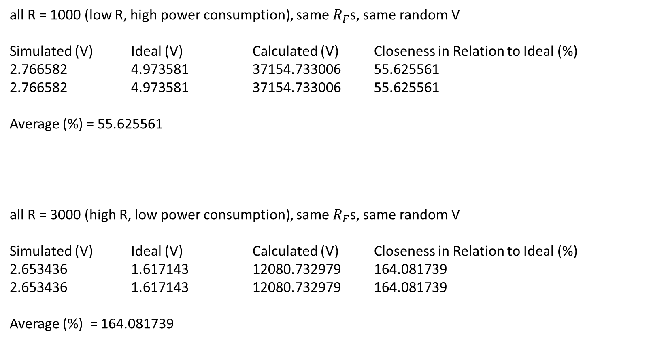
20 by 784 Synapses with NMOS & 8 steps R (Ex)
all R = 1000 (low R, high power consumption), same $R_{F}$s, same random V
Simulated (V) Ideal (V) Calculated (V) Closeness in Relation to Ideal (%)
2.766582 4.973581 37154.733006 55.625561
2.766582 4.973581 37154.733006 55.625561
Average (%) = 55.625561
all R = 3000 (high R, low power consumption), same $R_{F}$s, same random V
Simulated (V) Ideal (V) Calculated (V) Closeness in Relation to Ideal (%)
2.653436 1.617143 12080.732979 164.081739
2.653436 1.617143 12080.732979 164.081739
Average (%) = 164.081739

Slide 28
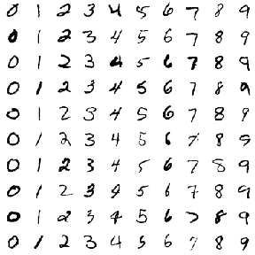



Auxiliary Simulation Details (Outline)
Tools of trade:
Tensorflow (Machine Learning Platform)
Keras (Python Deep Learning Library)
MNIST (Standard Handwritten Digit Dataset)
OpenCV (Computer vision and machine learning library)

Slide 29
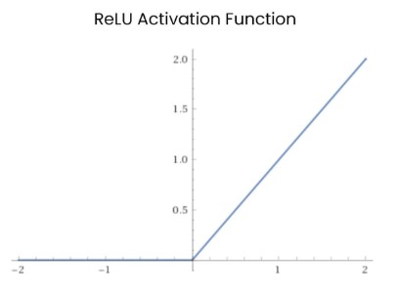
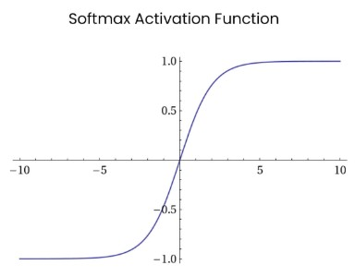
Auxiliary Simulation Result
Input -> FCN 100 -> output
Accuracy : 11.78%
Input -> FCN 100 with ReLU activation -> output
Accuracy : 11.35%
Input -> FCN 100 with ReLU activation -> output with ReLU activation
Accuracy : 9.80%
Input -> FCN 100 with ReLU activation -> output with softmax activation
Accuracy : 96.91%
Input -> FCN 100 with softmax activation -> output with softmax activation
Accuracy : 54.97%

Slide 30
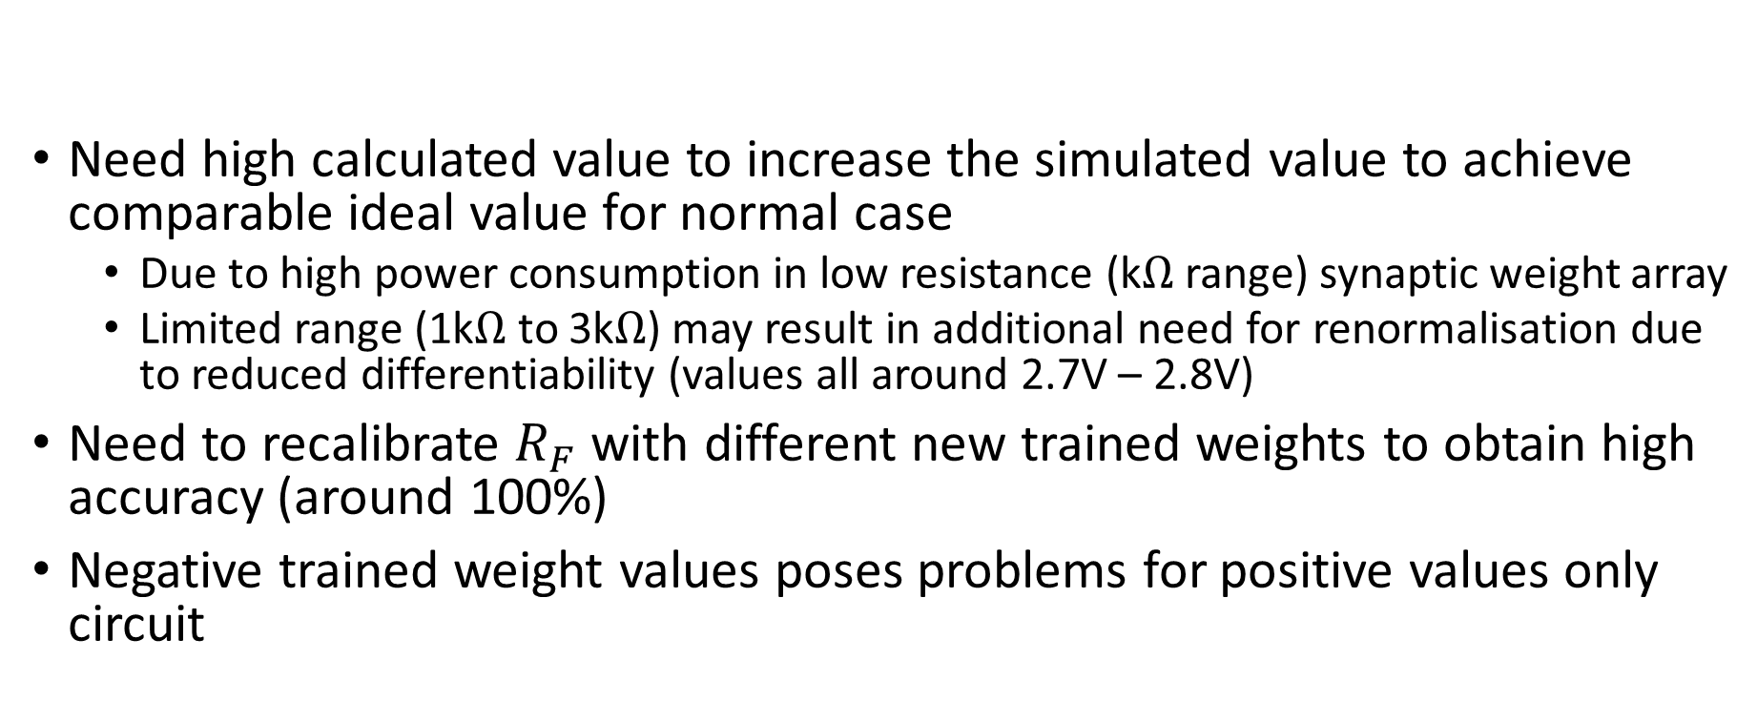
Discussion
Need high calculated value to increase the simulated value to achieve comparable ideal value for normal case
Due to high power consumption in low resistance (k$Ω$ range) synaptic weight array
Limited range (1k$Ω$ to 3k$Ω$) may result in additional need for renormalisation due to reduced differentiability (values all around 2.7V – 2.8V)
Need to recalibrate $R_{F}$ with different new trained weights to obtain high accuracy (around 100%)
Negative trained weight values poses problems for positive values only circuit

Slide 31
Planned Roadmap (subjected to change)
Develop a Single Simplified Spike-based Neuron Model
Spike-based Neuron Model Scaling
Spintronic MRAM testing and Integration
MNIST Data Simulation & Comparison
Spike-based MNIST Data Simulation & Comparison

